Slide 1
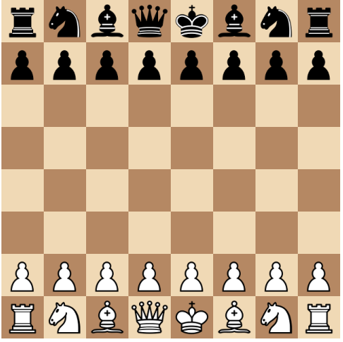
Python Chess
An app that allows a user to play chess against a bot of their choice
By Logan Gunnin
Github URL https://github.com/ksu-is/Python-Chess-Game

